Slide 1



Slide 2
About today…
React
HOCs

Slide 3

React

Slide 4

Intro to HOCs
Intro
A function that takes a component and returns a new component
Used for code reuse, logic, and bootstrap abstraction in
React applications

Slide 5
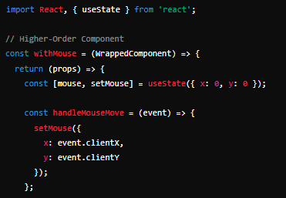
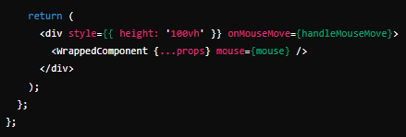
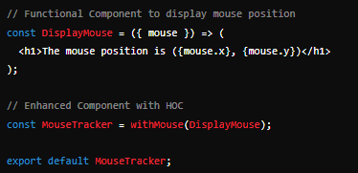
Basic example of HOCs

Slide 6
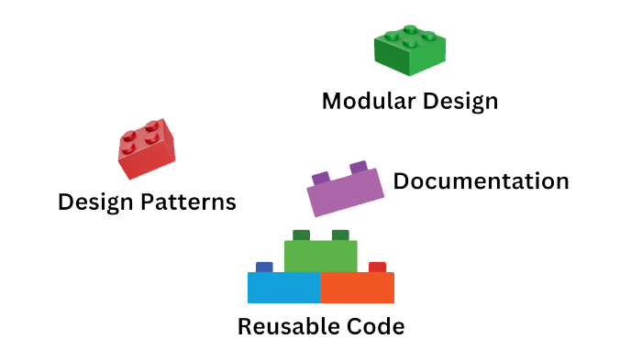
Benefits of HOCs
Code Reusability
Share common logic between multiple components
Separation of Concerns
Keep the component logic separate from UI rendering logic
Composition
Combine multiple HOCs to enhance components with various functionalities

Slide 7
Best Practices for HOCs
Purity
Ensure HOCs are pure and do not modify the original component
Performance
Avoid using too many HOCs to prevent performance issues
Naming Conventions
Use clear and consistent naming conventions for HOCs

Slide 8

What is a Higher-Order Component (HOC) in React?
A function that takes a component and returns a new component with enhanced functionality
How do HOCs differ from Render Props?
HOCs enhance a component by wrapping it and adding functionality, while Render Props involve passing a function as a prop to control rendering based on state
Can you use HOCs with functional components?
Yes, HOCs can be used with both class components and functional components
What is a common use case for HOCs?
Common use cases for HOCs include adding cross-cutting concerns like logging, authentication, or data fetching to multiple components

Slide 9


Slide 10

Task 1
Create a Higher-Order Component (HOC) to add a "click count" feature to a functional component

